Slide 1
Social Feature-based Multi-path Routing in Delay Tolerant Networks
Jie Wu and Yunsheng Wang
Department of Computer and Information Sciences
Temple University

Slide 2
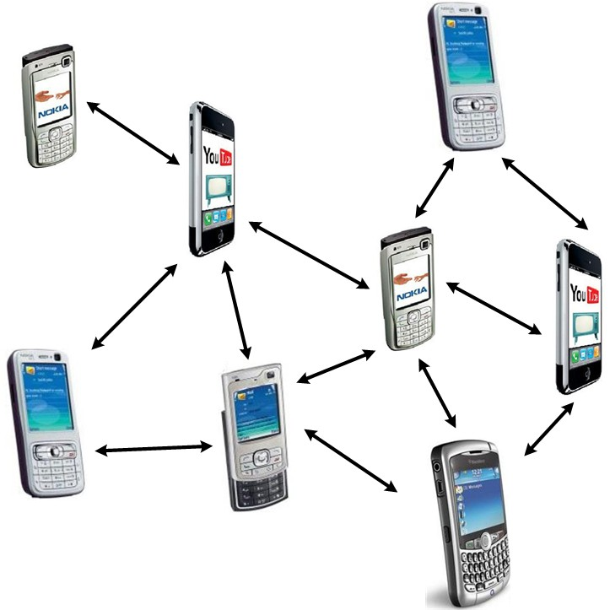
Delay Tolerant Networks (DTNs)
Occasionally connected networks
Examples of DTNs
    Deep space communication
    Wildlife monitoring
    Vehicular communication
    Social contact networks
  Efficient routing is still a main challenge!

Slide 3
Motivation 1
Existing DTN routing:
  contact history
  mobility pattern
Collecting such information is costly
We use internal social feature information for routing without overhead.

Slide 4
Motivation 2
Increase delivery rate: multiple copy
  Flooding (O(N))
  Delegation forwarding (O(√N))
It is hard to control the efficiency
Our approach:
  Feature-based (race, gender, language, …)
  logN *copies in node-disjoint paths
  (N * is a group: a node in the hypercube)

Slide 5
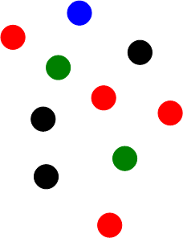
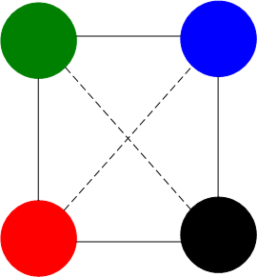
Social Feature
Mobile & unstructured contact space (M-space)
Static & structured feature space (F-space)
Each individual with a social feature profile {F₁, F₂,…}
Individuals with the same features mapped to a group

Slide 6
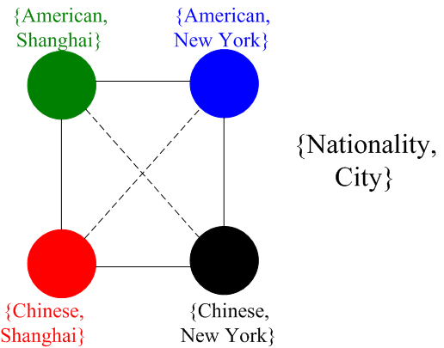
Example
P₃
P₂
P₁
      People come in contact with each other more frequently if they have more social features in common (P₁>P₃, P₂>P₃)

Slide 7

Feature Extraction
Extract m most important features
Extract most informative subset (MIS) with m(from m′) key features based on entropy
  E(F_{j}) : entropy of F_{j}
  p: probability mass function of F_{j}

Slide 8
The entropy of each social feature (Infocom 2006 trace)
Social Feature | Entropy
Affiliation | 4.64
City | 4.45
Nationality | 4.11
Language | 4.11
Country | 3.59
Position | 1.37

Slide 9
A 3-dimensional (3-D) hypercube
Dimension 1: city
Dimension 2: position
Dimension 3: gender
Position: professor (0), researcher (1), student (2)
Gender: male (0), female (1)
City: New York(0), London(1), Paris (2), Shanghai (3)
Example: “311” : a female researcher lives in Shanghai

Slide 10
Property of Hypercube
Efficient copy management in an m-d binary cube (S and D differ in k features)
m node-disjoint paths from S to D
  k shortest paths of length k
  m−k non-shortest paths of length k+2.

Slide 11
Hypercube Routing
The relative address of the current group and destination group (a small string in the header)
  calculated through XOR on S and D
  sent, along with the packet, to the next node
Any node in the group can forward to any node in the adjacent group
Special treatment is needed at the destination group

Slide 12
Coordinate sequence
  Path 1: <1, 2, 3> (red directed line)
  Path 2: <2, 3, 1> (blue directed line)
  Path 3: <3, 1, 2> (green directed line)
Node-disjointness

Slide 13
Example: Node-Disjoint-based Routing
S = G₀ and D = G₆

Slide 14
Example: Node-Disjoint-based Routing
2 shortest node-disjoint paths:
  <1, 2>: red directed line
  <2, 1>: blue directed line
1 non-shortest node-disjoint path:
  <3, 2, 1, 3>: dashed directed line

Slide 15
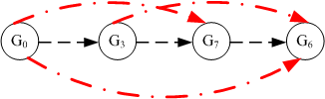
Shortcuts
Feature matching shortcut can resolve the feature distance more than one at a time.
Shortcut reduces the number of forwardings while ensuring the path disjointness property.

Slide 16
An example of the composite path from 0000 to 1111.
Composite path: all possible paths from one node to another in a certain dimension sequence, including the direct path (solid directed line) and all possible shortcut paths (dashed directed lines).

Slide 17
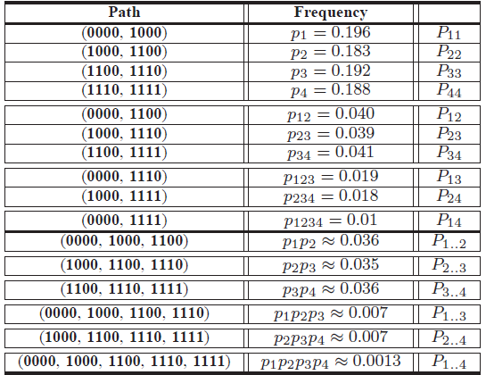
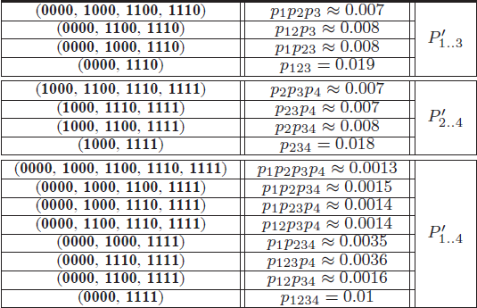
Comparison of contact frequency with different feature distance in the Infocom 2006 trace
Direct frequency: P_{i..j}
Shortcut frequency: P_{ij}
Composite frequency: P’_{i..j}

Slide 18
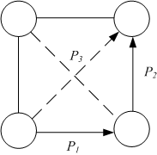
Two Observations
Observation 1: the shortcut frequency (Diagonal line) (P₃)
  smaller than each side (P₃ < P₁ or P₂)
  Larger than the product of two sides (P₃ > P₁ * P₂)
Observation 2: the composite frequency (Diagonal line) (P’_{1..2} = P₃ + P₁ * P₂)
  smaller than each side (P’_{1..2} < P₁ or P₂)
  Larger than the product of two sides (P’_{1..2} > P₁ * P₂)

Slide 19
Simulation
Synthetic trace
  A node A has m contact frequencies, p₁, p₂, . . . , p_{m}, with its m neighbors in the m-D F-space.
  128 individuals
  m is 4, 5, 7, 8, and 11.
Real trace
  Infocom 2006 trace.
  61 participants
  6 social features, m is 3, 4, 5, and 6.

Slide 20
7 routing schemes comparison
Node-disjoint-based with wait-at-destination (ND-W)
  Waiting for the destination after the packet enters the destination group
Node-disjoint-based with spray-at-destination (ND-S)
  Spraying N/(2M) copies into the destination group after the packet enters the group
Delegation-based with wait (D-W)
Delegation-based with spray (D-S)
  Delegation-based: The copies of a packet is only forwarded to the individual with a smallest feature distance to the destination it has met so far
Note: spray is needed at the destination group to increase the chances to meet the actual destination!

Slide 21
7 routing schemes comparison-cont’d
Source spray-and-wait (S-S&W)
  The source forwards copies to the first m distinct nodes it encounters. If the destination is not found, the copy carriers wait for the destination.
Binary spray-and-wait (B-S&W)
  Any node with copies will forward half of the copies to the encountered node with no copy.
Binary spray-and-focus (B-S&F)
  The copy carriers forward the copy to the encountered node with a smaller feature distance to the destination.

Slide 22
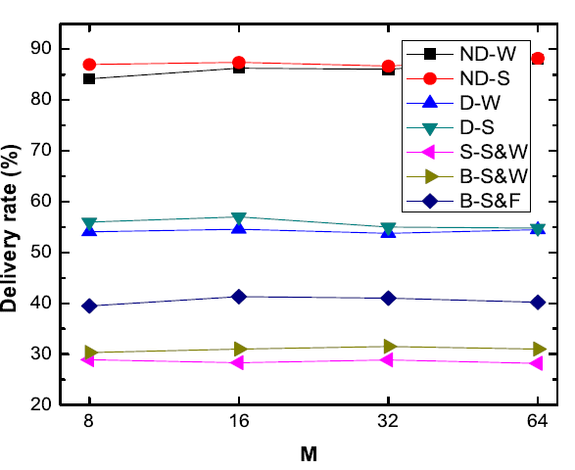
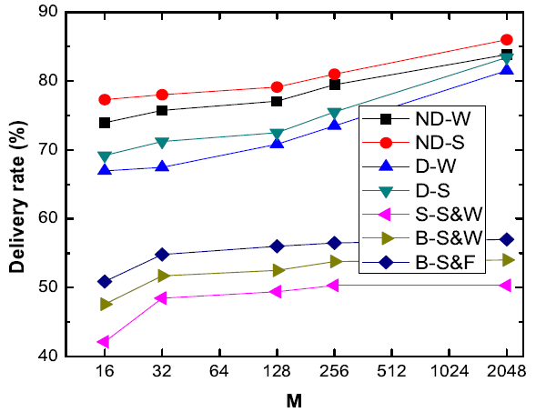
Varying node density – delivery rate
Real trace
Synthetic trace

Slide 23
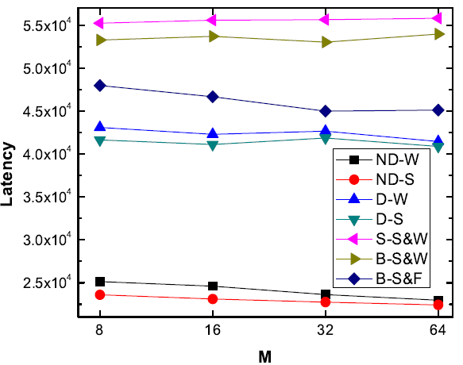
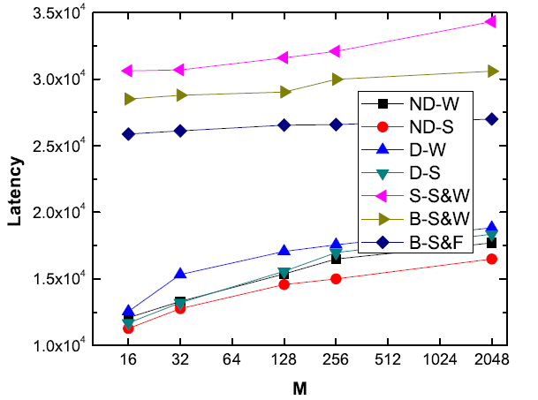
Varying node density – latency
Real trace
Synthetic trace

Slide 24
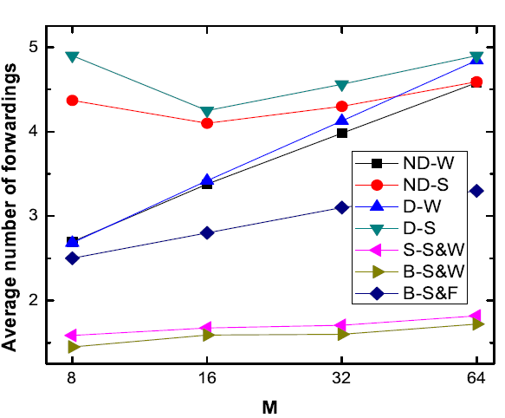
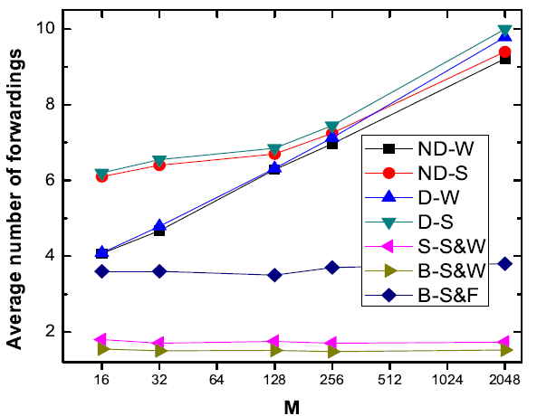
Varying node density – # of forwardings
Real trace
Synthetic trace

Slide 25
Conclusions
Unstructured mobile contact space (M-space)
Static structured social feature space (F-space)
Extract the most informative features to create a hypercube
Multi-path routing:
  Feature-based, efficient copy management, and node-disjoint-based
Future work
  Binary cubes to general cubes
  Network coding, e.g., Fountain code

Slide 26
Questions ?

Slide 27
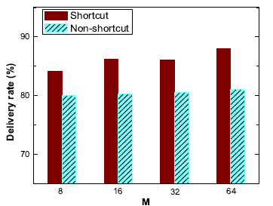
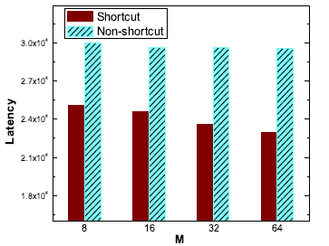
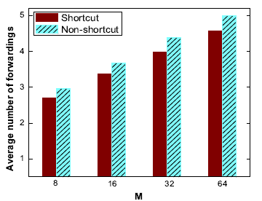
shortcut
Comparing shortcut and non-shortcut with 100 packets in the real trace

Slide 28
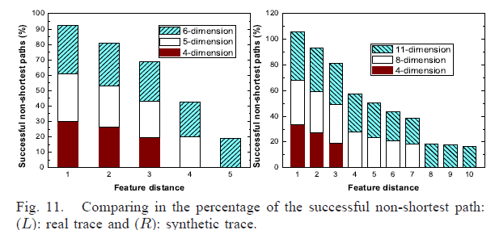
Non-shortest path

